Slide 1
Transaction Management
Database Management System (2130703) Darshan Institute of Engineering & Technology

Slide 2
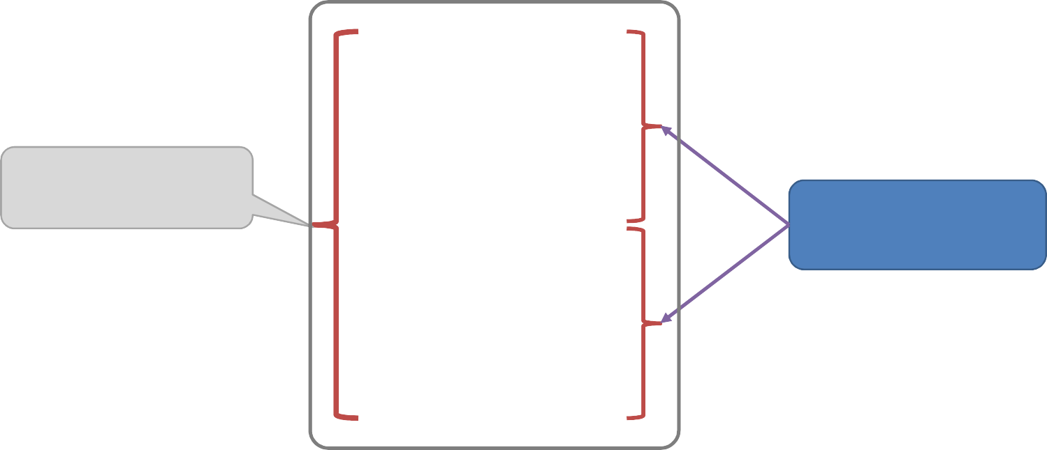
What is transaction?
A transaction is a sequence of operations performed as a single logical unit of work.
A transaction is a logical unit of work that contains one or more
SQL statements.
Example of transaction
Works as a single logical unit
read (A) A = A – 50
write (A) read (B) B = B + 50
write (B)
Transaction
Operations
2
2

Slide 3
ACID properties of transaction
Atomicity (Either transaction execute 0% or 100%)
Consistency (database must remain in a consistent state after any transaction)
Isolation (Intermediate transaction results must be hidden from other concurrently executed transactions)
Durability (Once a transaction completed successfully, the changes it has made into the database should be permanent)
Unit – 6: Transaction Management
3
2

Slide 4
ACID properties of transaction
Atomicity
This property states that a transaction must be treated as an atomic unit, that
0%
read (A)
A = A – 50
write (A)
is, either all of its operations are executed or none.
Either transaction execute 0% or 100%.
For example, consider a transaction to
read (B)
FAIL
B = B + 50
write (B)
100%
transfer Rs. 50 from account A to account B.
In this transaction, if Rs. 50 is deducted from account A then it must be added to account B.
Unit – 6: Transaction Management
4
Darshan Institute of Engineering & Technology
2

Slide 5
ACID properties of transaction
Consistency
A=500, B=500 A+B=1000
read (A) A = A – 50
write (A) read (B) B = B + 50
write (B) A=450, B=550
A+B=1000
The database must remain in a
consistent state after any transaction.
If the database was in a consistent state before the execution of a transaction, it
must remain consistent after the
execution of the transaction as well.
In our example, total of A and B must
remain same before and after the execution of transaction.
Unit – 6: Transaction Management
5
Darshan Institute of Engineering & Technology
2

Slide 6
ACID properties of transaction
Isolation
Changes occurring in a particular
read (A) A = A – 50
write (A) read (B) B = B + 50
write (B)
transaction will not be visible to any
other transaction until it has been committed.
Intermediate transaction results must
be hidden from other concurrently
executed transactions.
In our example once our transaction starts from first step (step 1) its result should not be access by any other transaction until last step (step 6) is completed.
Unit – 6: Transaction Management
2
Darshan Institute of Engineering & Technology

Slide 7
ACID properties of transaction
Durability
After a transaction completes successfully, the changes it has made to the database persist (permanent), even if there are system failures.
Once our transaction completed up to
A=500, B=500
read (A) A = A – 50
write (A) read (B) B = B + 50
write (B) A=450, B=550
last step (step 6) its result must be stored permanently. It should not be removed if system fails.
Unit – 6: Transaction Management
7
2

Slide 8
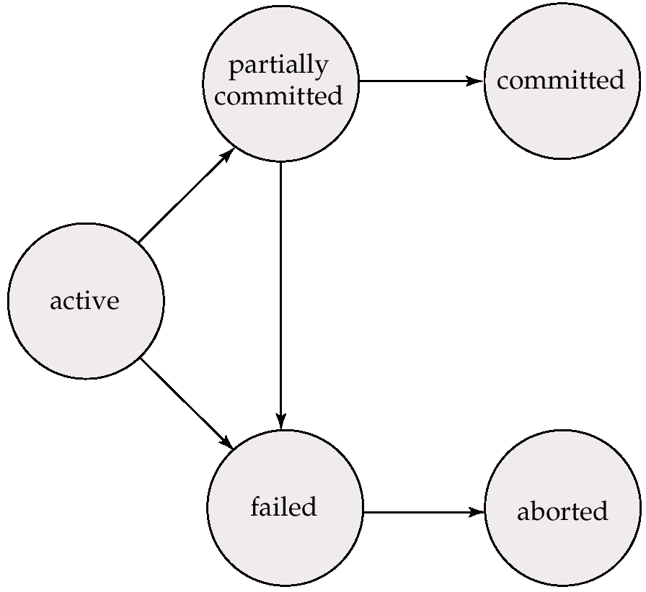
Transaction State Diagram \ State Transition Diagram
read (A) A = A – 50
write (A) read (B) B = B + 50
write (B)
Commit
Partial Committed
Committed
Active
End
Failed
Aborted
Unit – 6: Transaction Management
8
Darshan Institute of Engineering & Technology
2

Slide 9
Transaction State Diagram \ State Transition Diagram
Active
This is the initial state.
The transaction stays in this state while it is executing.
Partial Committed
When a transaction executes its final operation/ instruction, it is said to be in a partially committed state.
Failed
Discover that normal execution can no longer proceed.
Once a transaction cannot be completed, any changes that it made must be undone rolling it back.
Unit – 6: Transaction Management
10
10

Slide 10
Transaction State Diagram \ State Transition Diagram
Committed
The transaction enters in this state after successful completion of the transaction (after committing transaction).
We cannot abort or rollback a committed transaction.
Aborted
The state after the transaction has been rolled back and the database has been restored to its state prior to the start of the transaction.
Unit – 6: Transaction Management
11
Darshan Institute of Engineering & Technology

Slide 11
What is schedule?
A schedule is a process of grouping the transactions into one and
executing them in a predefined order.
A schedule is the chronological (sequential) order in which
instructions are executed in a system.
A schedule is required in a database because when some transactions execute in parallel, they may affect the result of the transaction.
Means if one transaction is updating the values which the other transaction is accessing, then the order of these two transactions will change the result of another transaction.
Hence a schedule is created to execute the transactions.
Unit – 6: Transaction Management
11
Darshan Institute of Engineering & Technology

Slide 12
Example of schedule
T1 | T2
Read (A) A = A - 50 Write (A) Read (B) B = B + 50 Write (B) Commit | Read (A) temp = A * 0.1 A = A - temp Write (A) Read (B) B = B + temp Write (B) Commit
A=B=1000
Read (1000)
A = 1000 - 50
Write (950)
Read (1000)
B = 1000 + 50
Write (1050) Commit
Read (950)
temp = 950 * 0.1
A = 950 - 95
Write (855)
Read (1050)
B = 1050 + 95
Write (1145) Commit
Unit – 6: Transaction Management
11
Darshan Institute of Engineering & Technology

Slide 13
Example of schedule
T1 | T2
Read (A)
Temp = A * 0.1
A = A - temp
Write (A)
Read (B)
B = B + temp
Write (B)
Commit
 | Read (A)
 | A = A - 50
 | Write (A)
 | Read (B)
 | B = B + 50
 | Write (B)
 | Commit
A=B=1000
Read (1000)
Temp = 1000 * 0.1
A = 1000 - 100
Write (900)
Read (1000)
B = 1000 + 100
Write (1100) Commit Read (900)
A = 900 - 50
Write (850)
Read (1100)
B = 1100 + 50
Write (1150) Commit
Unit – 6: Transaction Management
11
Darshan Institute of Engineering & Technology

Slide 14
Serial schedule
A serial schedule is one in which no transaction starts until a running transaction has ended.
Transactions are executed one after the other.
This type of schedule is called a serial schedule, as transactions are executed in a serial manner.
Unit – 6: Transaction Management
11

Slide 15
Example of serial schedule
T1 | T2
Read (A)
Temp = A * 0.1
A = A - temp
Write (A)
Read (B)
B = B + temp
Write (B)
Commit
 | Read (A)
 | A = A - 50
 | Write (A)
 | Read (B)
 | B = B + 50
 | Write (B)
 | Commit
Unit – 6: Transaction Management
11
Darshan Institute of Engineering & Technology

Slide 16
Example of serial schedule
T1 | T2
Read (A) Temp = A * 0.1 A = A - temp Write (A) Read (B) B = B + temp Write (B) Commit | Read (A) A = A - 50 Write (A) Read (B) B = B + 50 Write (B) Commit
Unit – 6: Transaction Management
11
Darshan Institute of Engineering & Technology

Slide 17
Interleaved schedule
Schedule that interleave the execution of different transactions.
Means second transaction is started before the first one could end and execution can switch between the transactions back and forth.
Unit – 6: Transaction Management
11

Slide 18
Example of interleaved schedule
T1 | T2
Read (B) B = B + temp Write (B) Commit | Read (A) Temp = A * 0.1 A = A - temp Write (A)
 | Read (A) A = A - 50 Write (A)
Read (B) B = B + 50 Write (B) Commit
Unit – 6: Transaction Management
11
Darshan Institute of Engineering & Technology

Slide 19
Example of interleaved schedule
T1 | T2
Read (A) A = A - 50 Write (A)
 | Read (B) B = B + 50 Write (B) Commit
Read (A) Temp = A * 0.1 A = A - temp Write (A)
 | Read (B) B = B + temp Write (B) Commit
Unit – 6: Transaction Management
20
20

Slide 20
Equivalent schedule
If two schedules produce the same result after execution, they are said to be equivalent schedule.
They may yield the same result for some value and different results for another set of values.
That's why this equivalence is not generally considered significant.
Unit – 6: Transaction Management
21

Slide 21
Equivalent schedule
T1 | T2
Read (A) A = A - 50 Write (A) Commit | Read (A) Temp = A * 0.1 A = A - temp Write (A) Commit
Read (B) B = B + 50 Write (B) Commit | Read (B) B = B + temp Write (B) Commit
T1 | T2
Read (A) A = A - 50 Write (A) Read (B) B = B + 50 Write (B) Commit | Read (A) Temp = A * 0.1 A = A - temp Write (A) Read (B) B = B + temp Write (B) Commit
Both schedules are equivalent
In both schedules the sum “A + B” is preserved.
Unit – 6: Transaction Management
21
Darshan Institute of Engineering & Technology

Slide 22
Serializability
A schedule is serializable if it is equivalent to a serial schedule.
In serial schedules, only one transaction is allowed to execute at a time i.e. no concurrency is allowed.
Whereas in serializable schedules, multiple transactions can
execute simultaneously i.e. concurrency is allowed.
Types (forms) of serializability
Conflict serializability
View serializability
Unit – 6: Transaction Management
21
Darshan Institute of Engineering & Technology

Slide 23
Conflicting instructions
Let l_{i} and l_{j} be two instructions of
transactions T_{i} and T_{j}
respectively.
1. l_{i} = read(Q), l_{j} = read(Q) l_{i} and l_{j} don’t conflict
T1 | T2
read (Q)
 | read (Q)
T1 | T2
 | read (Q)
read (Q)
l_{i} = read(Q), l_{j} = write(Q)
l_{i} and l_{j} conflict
l_{i} = write(Q), l_{j} = read(Q) l_{i} and l_{j} conflict
l_{i} = write(Q), l_{j} = write(Q) l_{i} and l_{j} conflict
T1 | T2
read (Q)
 | write(Q)
T1 | T2
 | write(Q)
read (Q)
T1 | T2
write(Q)
 | read (Q)
T1 | T2
 | read (Q)
write(Q)
T1 | T2
write(Q)
 | write(Q)
T1 | T2
 | write(Q)
write(Q)
Unit – 6: Transaction Management
21
Darshan Institute of Engineering & Technology

Slide 24
Conflicting instructions
Instructions l_{i} and l_{j} conflict if and only if there exists some item Q accessed by both li and lj, and at least one of these instructions wrote Q.
If both the transactions access different data item then they are
not conflict.
Unit – 6: Transaction Management
21
Darshan Institute of Engineering & Technology

Slide 25
Conflict serializability
If a given schedule can be converted into a serial schedule by swapping its non-conflicting operations, then it is called as a conflict serializable schedule.
Unit – 6: Transaction Management
21
Darshan Institute of Engineering & Technology

Slide 26
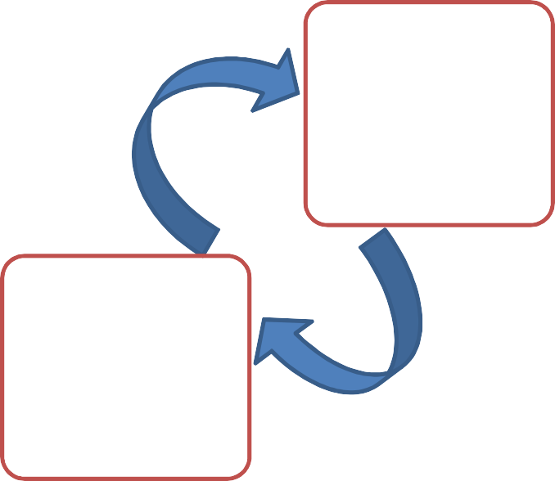
Conflict serializability (example)
T1 | T2
Read (A) A = A - 50 Write (A)
 | Read (A) Temp = A * 0.1 A = A - temp Write (A)
Read (B) B = B + 50 Write (B) Commit | Read (B) B = B + temp Write (B) Commit
T1 | T2
Read (A) A = A - 50 Write (A) Read (B) B = B + 50 Write (B) Commit | Read (A) Temp = A * 0.1 A = A - temp Write (A) Read (B) B = B + temp Write (B) Commit
Unit – 6: Transaction Management
21
Darshan Institute of Engineering & Technology

Slide 27
Conflict serializability
Example of a schedule that is not conflict serializable:
T1 | T2
Read (A) Read (A) | Write (A)
We are unable to swap instructions in the above schedule to obtain either the serial schedule < T1, T2 >, or the serial schedule
< T2, T1 >.
Unit – 6: Transaction Management
21

Slide 28
View serializability
Let S1 and S2 be two schedules with the same set of transactions. S1 and S2 are view equivalent if the following three conditions are satisfied, for each data item Q
Initial Read
Updated Read
Final Write
Unit – 6: Transaction Management
21
Darshan Institute of Engineering & Technology

Slide 29
Initial Read
If in schedule S1, transaction T_{i} reads the initial value of Q, then in schedule S2 also transaction Ti must read the initial value of Q.
S1 S3 S2
T1 | T2
Read (A) | Write (A)
T1 | T2
Write (A) | Read (A)
T1 | T2
Read (A) | Write (A)
Above two schedules S1 and S3 are not view equivalent because initial read operation in S1 is done by T1 and in S3 it is done by T2.
Above two schedules S1 and S2 are view equivalent because initial read operation in S1 is done by T1 and in S2 it is also done by T1.
Unit – 6: Transaction Management
30
Darshan Institute of Engineering & Technology
30

Slide 30
Updated Read
If in schedule S1 transaction T_{i} executes read(Q), and that value was produced by transaction T_{j} (if any), then in schedule S2 also transaction Ti must read the value of Q that was produced by transaction Tj.
S1
S3
T1 | T2 | T3
Write (A) | Write (A) | Read (A)
T1 | T2 | T3
Write (A) | Write (A) | Read (A)
Above two schedules are not view equal because, in S1, T3 is reading A that is updated by T2 and in S3, T3 is reading A which is updated by T1.
Unit – 6: Transaction Management
31
Darshan Institute of Engineering & Technology
31

Slide 31
Updated Read
If in schedule S1 transaction T_{i} executes read(Q), and that value was produced by transaction T_{j} (if any), then in schedule S2 also transaction T_{i} must read the value of Q that was produced by the same write(Q) operation of transaction T_{j}.
S1
S2
T1 | T2 | T3
Write (A) | Read (A) Write (A) | Read (A)
T1 | T2 | T3
Write (A) | Read (A) Write (A) | Read (A)
Above two schedules are view equal because, in S1, T3 is reading A that is updated by T2 and in S3 also, T3 is reading A which is updated by T2.
Unit – 6: Transaction Management
32
Darshan Institute of Engineering & Technology
31

Slide 32
Final Write
If T_{i} performs the final write on the data value in S1, then it also performs the final write on the data value in S2.
S1
S2
T1 | T2 | T3
Write (A) | Read (A) | Write (A)
T1 | T2 | T3
Write (A) | Read (A) | Write (A)
Above two schedules is view equal because final write operation in S1 is done by T3 and in S2 also the final write operation is also done by T3.
Unit – 6: Transaction Management
33
31

Slide 33
Two phase commit protocol
Two phase commit protocol ensures that all participants perform the same action (either to commit or to rollback a transaction).
It is designed to ensure that either all the databases are updated or none of them, so that the databases remain synchronized.
In two phase commit protocol there is one node which is act as a coordinator or controlling site and all other participating node are known as cohorts or participant or slave.
Coordinator (controlling site) – the component that coordinates with all the participants.
Cohorts (Participants/Slaves) – each individual node except coordinator are participant.
Unit – 6: Transaction Management
34
Darshan Institute of Engineering & Technology
31

Slide 34
Two phase commit protocol
As the name suggests, the two phase commit protocol involves two phases.
Commit request phase OR Prepare phase
Commit/Abort phase
Unit – 6: Transaction Management
35
Darshan Institute of Engineering & Technology
31

Slide 35





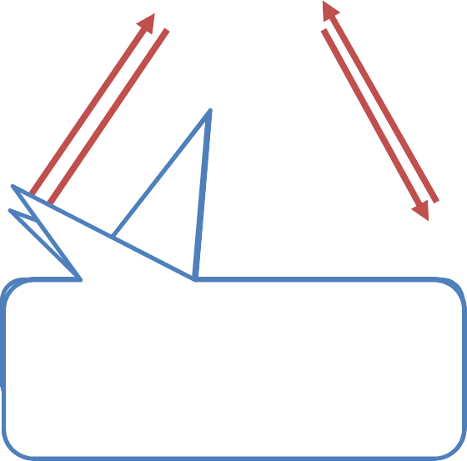




Two phase commit protocol
Prepare Phase
Commit Phase
CPSCoeaonorotdrridcd“iiipnanacakntto”otrrstoeisnneifndofdrormermptloy do cwroehmqeumtehsiettrarcseokamindmgy ftiotordroenaedoyr cntoomtcommitmoirt not
Unit – 6: Transaction Management
36
Darshan Institute of Engineering & Technology
31

Slide 36
Two phase commit protocol
Commit Request Phase (Obtaining Decision)
After each slave has locally completed its transaction, it sends a “DONE” message to the controlling site.
When the controlling site has received “DONE” message from all slaves, it
sends a “Prepare” (prepare to commit) message to the slaves.
The slaves vote on whether they still want to commit or not.
If a slave wants to commit, it sends a “Ready” message.
A slave that does not want to commit sends a “Not Ready” message.
This may happen when the slave has conflicting concurrent transactions or there is a timeout.
Unit – 6: Transaction Management
37
Darshan Institute of Engineering & Technology
31

Slide 37
Two phase commit protocol
Commit Phase (Performing Decision)
After the controlling site has received “Ready” message from all the slaves:
The controlling site sends a “Global Commit” message to the slaves.
The slaves commit the transaction and send a “Commit ACK” message to the controlling site.
When the controlling site receives “Commit ACK” message from all the slaves, it considers the transaction as committed.
Unit – 6: Transaction Management
38
Darshan Institute of Engineering & Technology
31

Slide 38
Two phase commit protocol
Commit Phase (Performing Decision)
After the controlling site has received the first “Not Ready” message
from any slave:
The controlling site sends a “Global Abort” message to the slaves.
The slaves abort the transaction and send a “Abort ACK” message to the controlling site.
When the controlling site receives “Abort ACK” message from all the slaves, it considers the transaction as aborted.
Unit – 6: Transaction Management
39
Darshan Institute of Engineering & Technology
31

Slide 39
Database recovery
There are many situations in which a transaction may not reach a commit or abort point.
Operating system crash
DBMS crash
System might lose power (power failure)
Disk may fail or other hardware may fail (disk/hardware failure)
Human error
In any of above situations, data in the database may become inconsistent or lost.
Unit – 6: Transaction Management
40
Darshan Institute of Engineering & Technology
40

Slide 40
Database recovery
For example, if a transaction has completed 30 out of 40 write instructions to the database when the DBMS crashes, then the database may be in an inconsistent state as only part of the transaction’s work was completed.
Database recovery is the process of restoring the database and the data to a consistent state.
This may include restoring lost data up to the point of the event
(e.g. system crash).
Unit – 6: Transaction Management
41
Darshan Institute of Engineering & Technology

Slide 41
Log based recovery method
The log is a sequence of log records, which maintains information about update activities on the database.
A log is kept on stable storage (i.e HDD).
Log contains
Start of transaction
Transaction-id
Record-id
Type of operation (insert, update, delete)
Old value, new value
End of transaction that is committed or aborted.
Unit – 6: Transaction Management
41
Darshan Institute of Engineering & Technology

Slide 42
Log based recovery method
When transaction T_{i} starts, it registers itself by writing a record
<T_{i} start> to the log
Before T_{i} executes write(X), a log record <T_{i}, X, V1, V2> is written, where V1 is the value of X before the write (the old value), and V2 is the value to be written to X (the new value).
When T_{i} finishes it last statement, the log record <T_{i} commit> is written.
Undo of a log record <Ti, X, V1, V2> writes the old value V1 to X
Redo of a log record <Ti, X, V1, V2> writes the new value V2 to X
Types of log based recovery method
Immediate database modification
Deferred database modification
Unit – 6: Transaction Management
41
Darshan Institute of Engineering & Technology

Slide 43


Immediate v/s Deferred database modification
Immediate database modification Deferred database modification
Updates (changes) to the database are Updates (changes) to the database are
applied immediately as they occur without deferred (postponed) until the transaction waiting to reach to the commit point. commits.
A=500, B=600, C=700
T1 | T2
Read (A)
A = A - 100
Write (A)
Read (B)
B = B + 100
Write (B)
Commit
 | Read (C)
 | C = C - 200
 | Write (C)
 | Commit
A=500, B=600, C=700
<T1 start>
<T1 start>
<<T1^{T1}, A^{s},^{ta}4^{r}0^{t}0>>
<<TT11, A_{B}s,ta₇4r0t0>>
A=5<0^{T}0¹,B, =^{AB}6,0⁷⁴0⁰,C⁰=>700
<<TT11, ,CBo,m70m0i>t>
<T<1T, 2Costmarmt>it>
<T<2T,2Cs,t5ar0t0>>
<<TT22, ,CCo,m50m0i>t>
A=400,B=700,C=7500
<T1<, A^{T1}, 5^{s}0^{ta}0^{r},^{t}4>00>
<T1<, TA1, 5st0a0r,t>400>
<T1, B, 600, 700>
A<=^{T}4¹0,,0^{AB},B, =⁵⁶7⁰0⁰0,,C⁴⁷=⁰7⁰0>0
<T<1T,1B,,C6o0m0,m7i0t>0>
<T<1T, 2Cosmtamrt>it>
<T2,<CT,27s0ta0r,t5>00>
<T<2T,2C,,C7o0m0,m5i0t>0>
A=400,,B=700,,C=500
Unit – 6: Transaction Management
41
Darshan Institute of Engineering & Technology

Slide 44
Immediate v/s Deferred database modification
Immediate database modification | Deferred database modification
Updates (changes) to the database are applied immediately as they occur without waiting to reach to the commit point. | Updates (changes) to the database are deferred (postponed) until the transaction commits.
If transaction is not committed, then we need to do undo operation and restart the transaction again. | If transaction is not committed, then no need to do any undo operations. Just restart the transaction.
If transaction is committed, then no need to do redo the updates of the transaction. | If transaction is committed, then we need to do redo the updates of the transaction.
Undo and Redo both operations are performed. | Only Redo operation is performed.
Unit – 6: Transaction Management
41
Darshan Institute of Engineering & Technology

Slide 45
Problems with Deferred & Immediate Updates
Searching the entire log is time consuming.
Immediate database modification
When transaction fail log file is used to undo the updates of transaction.
Deferred database modification
When transaction commits log file is used to redo the updates of transaction.
To reduce the searching time of entire log we can use check point.
Unit – 6: Transaction Management
41
Darshan Institute of Engineering & Technology

Slide 46
Checkpoint
It is a point which specifies that any operations executed before it are done correctly and stored safely (updated safely in database).
At this point, all the buffers are force-fully written to the
secondary storage (database).
Checkpoints are scheduled at predetermined time intervals.
It is used to limit:
Size of transaction log file
Amount of searching
Unit – 6: Transaction Management
41
Darshan Institute of Engineering & Technology

Slide 47
Checkpoint works when failure occurs
Time T_{C} T_{f}
T1
T2
T3
T4
Checkpoint time
Failure
At failure time:
Ignore the transaction T1 as it has already been committed before
checkpoint.
Redo transaction T2 and T3 as they are active after checkpoint and are committed before failure.
Undo transaction T4 as it is active after checkpoint and has not committed.
Unit – 6: Transaction Management
41
Darshan Institute of Engineering & Technology

Slide 48
Page table structure
The database is partitioned into fixed-length blocks referred to as PAGES.
Page table has n entries – one for each database page.
Each entry contain pointer to a page on disk.
1
2
3
4
5
.
n
2
1
4
101
202
n
1
2
3
4
: :
101
: :
201
202
n
Page Table
Pages
Pages on disk
Unit – 6: Transaction Management
41
Darshan Institute of Engineering & Technology

Slide 49
Shadow paging technique
Shadow paging is an alternative to log-based recovery.
This scheme is useful if transactions execute serially.
It maintain two page tables during the lifetime of a transaction
current page table
shadow page table
Shadow page table is stored on non-volatile storage.
When a transaction starts, both the page tables are identical.
Only current page table is updated for data item accesses
(changed) during execution of the transaction.
Shadow page table is never modified during transaction.
execution of
Unit – 6: Transaction Management
50
Darshan Institute of Engineering & Technology
50

Slide 50
Shadow paging technique
Page 1
Page 2
Page 3
Page 4
Page 5
Page 1
Page 2
Page 3
Page 4
Page 5
Page 1
Page 2
Page 3
Page 4
Page 5
Current page table
Pages
Shadow page table
Two pages - page 2 & 5 - are affected by a transaction and copied to new physical pages. The current page table points to these pages.
Unit – 6: Transaction Management
51
Darshan Institute of Engineering & Technology

Slide 51
Shadow paging technique
Whenever any page is updated first time
A copy of this page is made onto an unused page
The current page table is then made to point to the copy
The update is performed on the copy
Unit – 6: Transaction Management
51
Darshan Institute of Engineering & Technology

Slide 52
Shadow paging technique
Page 1
Page 2
Page 3
Page 4
Page 5
Page 1
Page 2 (old)
Page 3
Page 4
Page 5 (old)
Page 2 (new)
Page 5 (new)
Page 1
Page 2
Page 3
Page 4
Page 5
Current page table
Pages
Shadow page table
Two pages - page 2 & 5 - are affected by a transaction and copied to new physical pages. The current page table points to these pages.
Unit – 6: Transaction Management
51
Darshan Institute of Engineering & Technology

Slide 53
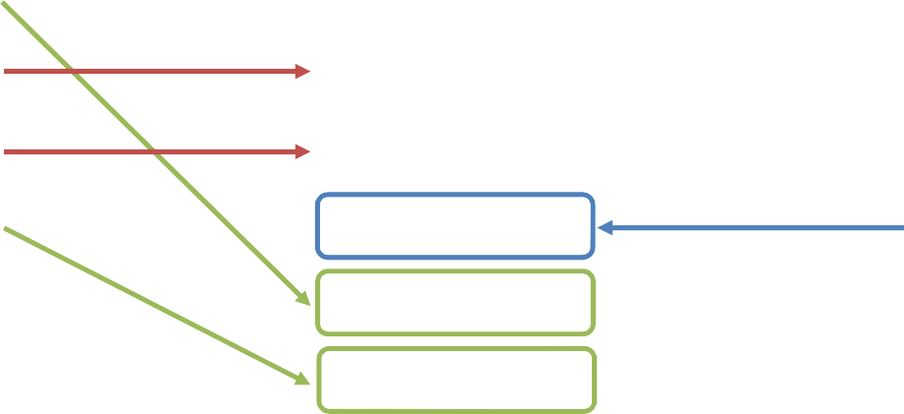
Shadow paging technique
Page 1
Page 2
Page 3
Page 4
Page 5
Page 1
Page 2 (old)
Page 3
Page 4
Page 5 (old)
Page 2 (new)
Page 5 (new)
Page 1
Page 2
Page 3
Page 4
Page 5
Current page table
Pages
Shadow page table
The shadow page table continues to point to old pages which are not changed by the transaction. So, this table and pages are used for undoing the transaction.
Unit – 6: Transaction Management
51
Darshan Institute of Engineering & Technology

Slide 54
Shadow paging technique
When transaction start, both the page tables are identical.
The shadow page table is never changed over the duration of the transaction.
The current page table will be changed when a transaction performs a write operation.
All input and output operations use the current page table.
Whenever any page is about to be written for the first time
A copy of this page is made onto an unused page
The current page table is then made to point to the copy
The update is performed on the copy
When the transaction completes, the current page table becomes shadow page table. At this time, it is considered that the transaction has committed.
Unit – 6: Transaction Management
51
Darshan Institute of Engineering & Technology

Slide 55
What is concurrency?
Concurrency is the ability of a database to allow multiple (more than one) users to access data at the same time.
Three problems due to concurrency
Lost update problem
Dirty read problem
Incorrect retrieval problem
Unit – 6: Transaction Management
51
Darshan Institute of Engineering & Technology

Slide 56
Lost update problem
This problem indicate that if two transactions T1 and T2
X=100
both read the same data and update it then effect of first update will be overwritten by the second update.
How to avoid: A transaction T2 must not update the data item (X) until the transaction T1 can commit data item (X).
T1 | Time | T2
--- | T0 | ---
Read X | T1 | ---
--- | T2 | Read X
Update X X=75 | T3 | ---
--- | T4 | Update X X=50
--- | T5 | ---
Unit – 6: Transaction Management
51

Slide 57
Dirty read problem
The dirty read arises when one transaction update some item and then fails due to some reason. This updated item is
X=100
T1 | Time | T2
--- | T0 | ---
--- | T1 | Update X X=50
Read X | T2 | ---
--- | T3 | Rollback
--- | T4 | ---
retrieved transaction
by another before it is
changed back to the original value.
How to avoid: a transaction T1 must not read the data item (X) until the transaction T2 can commit data item (X).
Unit – 6: Transaction Management
51
Darshan Institute of Engineering & Technology

Slide 58
Incorrect retrieval problem
Balance (A=200, B=250, C=150)
T1 Time T2
Read (A) T1 --- Sum  200
Read (B) T2 --- Sum  Sum + 250 = 450
--- T3 Read (C)
Update (C) --- T4 150 → 150 – 50 = 100
--- T5 Read (A)
Update (A) --- T6 200 → 200 + 50 = 250
--- T7 COMMIT
Read (C) T8 --- Sum Sum + 100 = 550
Unit – 6: Transaction Management
51
Darshan Institute of Engineering & Technology

Slide 59
The incorrect retrieval problem
The inconsistent retrieval problem arises when one transaction retrieves data to use in some operation but before it can use this data another transaction updates that data and commits.
Through this change will be hidden from first transaction and it will continue to use previous retrieved data. This problem is also known as inconsistent analysis problem.
How to avoid: A transaction T2 must not read or update data item (X) until the transaction T1 can commit data item (X).
Unit – 6: Transaction Management
60
Darshan Institute of Engineering & Technology
60

Slide 60




What is lock?
A lock is a variable associated with concurrent access to that data item.
data item to control
Locking is a strategy that is used to prevent such concurrent access of data.
Lock variable 1
0
Database
Unit – 6: Transaction Management
61
Darshan Institute of Engineering & Technology
Unit – 6: Transaction Management
61
Darshan Institute of Engineering & Technology

Slide 61
Lock based protocol
Data items can be locked in two modes :
Shared (S) mode: When we take this lock we can just read the item but
cannot write.
Exclusive (X) mode: When we take this lock we can read as well as write
the item.
Lock-compatibility matrix
T1
T2
 | Shared lock | Exclusive lock
Shared lock | Yes Compatible | No Not Compatible
Exclusive lock | No Not Compatible | No Not Compatible
Unit – 6: Transaction Management
62
Darshan Institute of Engineering & Technology
Unit – 6: Transaction Management
61
Darshan Institute of Engineering & Technology

Slide 62
Lock based protocol
A transaction may be granted a lock on an item if the requested lock is compatible with locks already held on the item by other transactions.
If a lock cannot be granted, the requesting transaction is made to wait till all incompatible locks held by other transactions have been released. The lock is then granted.
Any number of transactions can hold shared locks on an item, but if any transaction holds an exclusive on the item no other transaction can hold any lock on the item.
Unit – 6: Transaction Management
63
Darshan Institute of Engineering & Technology
Unit – 6: Transaction Management
61
Darshan Institute of Engineering & Technology

Slide 63
Lock based protocol
This locking protocol divides transaction execution phase into three parts:
When transaction starts executing, create a list of data items on which they need locks and requests the system for all the locks it needs.
Where the transaction acquires all locks and no other lock is required.
Transaction keeps executing its operation.
As soon as the transaction releases its first lock, the third phase starts. In this phase a transaction cannot demand for any lock but only releases the acquired locks.
Transaction
Lock acquisition phase
execution
Lock releasing phase
Transaction
T begin
Unit – 6: Transaction Management
T end
Time
64
Darshan Institute of Engineering & Technology

Slide 64
Two phase locking protocol
This protocol works in two phases,
Growing Phase
In this phase a transaction obtains locks, but can not release any lock.
When a transaction takes the final lock is called lock point.
Shrinking Phase
In this phase a transaction can release locks, but can not obtain any lock.
The transaction enters the shrinking phase as soon as it releases the first lock after crossing the Lock Point.
Growing phase Shrinking phase
Transaction
T begin
Unit – 6: Transaction Management
T end
Time
64
Darshan Institute of Engineering & Technology

Slide 65
Strict two phase locking protocol
In this protocol, a transaction may release all the shared locks after the Lock Point has been reached, but it cannot release any of the exclusive locks until the transaction commits or aborts.
It ensures that if data is being modified by one transaction, then other transaction cannot read it until first transaction commits.
This protocol solves dirty read problem.
Unit – 6: Transaction Management
66
Darshan Institute of Engineering & Technology

Slide 66
Rigorous two phase locking protocol
In this protocol, a transaction is not allowed to release any lock (either shared or exclusive) until it commits.
This means that until the transaction commits, other transaction can not acquire even a shared lock on a data item on which the uncommitted transaction has a shared lock.
Unit – 6: Transaction Management
66
Darshan Institute of Engineering & Technology

Slide 67
Time stamp based protocol
This protocol uses either system time or logical counter to be used as a time-stamp.
Every transaction has a time-stamp associated with it and the
ordering is determined by the age of the transaction.
A transaction ‘T1’ created at 0002 clock time would be older than all other transaction, which come after it.
For example, any transaction ‘T2' entering the system at 0004 is two seconds younger than transaction ‘T1’ and priority is given to the older one.
In addition, every data item is given the latest read and write time-stamp. This lets the system know, when last read and write operations was made on the data item.
Unit – 6: Transaction Management
66
Darshan Institute of Engineering & Technology

Slide 68
Time stamp ordering protocol
This is the responsibility of the protocol system that the conflicting pair of tasks should be executed according to the timestamp values of the transactions.
Time-stamp of Transaction Ti is denoted as TS(Ti).
Read time-stamp of data-item X is denoted by R-timestamp(X).
Write time-stamp of data-item X is denoted by W-timestamp(X).
Unit – 6: Transaction Management
66
Darshan Institute of Engineering & Technology

Slide 69
Time stamp ordering protocol
Timestamp ordering protocol works as follows:
If a transaction Ti issues read(X) operation:
If TS(Ti) < W-timestamp(X)
Operation rejected.
If TS(Ti) >= W-timestamp(X)
Operation executed.
If a transaction Ti issues write(X) operation:
If TS(Ti) < R-timestamp(X)
Operation rejected.
If TS(Ti) < W-timestamp(X)
Operation rejected and Ti rolled back.
Otherwise, operation executed.
Unit – 6: Transaction Management
70
70

Slide 70
What is deadlock?
Consider the following two transactions:
T1
T2
Granted for (A)
Lock-X (A) Write (A)
Lock-X (B) Write (B)
Lock-X (A) Write (A)
Granted for (B)
Waiting for (A)
Waiting for (B)
Lock-X (B) Write (B)
A deadlock is a situation in which two or more transactions are waiting for one another to give up locks.
Unit – 6: Transaction Management
Darshan Institute of Engineering & Technology

Slide 71
Deadlock detection
A simple way to detect deadlock is with the help of wait-for graph.
One node is created in the wait-for graph for each transaction that is currently executing.
Whenever a transaction Ti is waiting to lock an item X that is currently locked by a transaction Tj, a directed edge from Ti to Tj (Ti→Tj) is created in the wait-for graph.
When Tj releases the lock(s) on the items that Ti was waiting for, the directed edge is dropped from the wait-for graph.
We have a state of deadlock if and only if the wait-for graph has a cycle.
Then each transaction involved in the cycle is said to be deadlocked.
Unit – 6: Transaction Management
71
Darshan Institute of Engineering & Technology

Slide 72
Deadlock detection
B
D
Transaction A is waiting for transactions B and C.
Transactions C is waiting for transaction B.
Transaction B is waiting for transaction D.
This wait-for graph has no cycle, so there is no deadlock state.
A
C
Suppose now that transaction D is requesting an item held by C. Then the edge D C is added to the wait-for graph.
Unit – 6: Transaction Management
71
Darshan Institute of Engineering & Technology

Slide 73
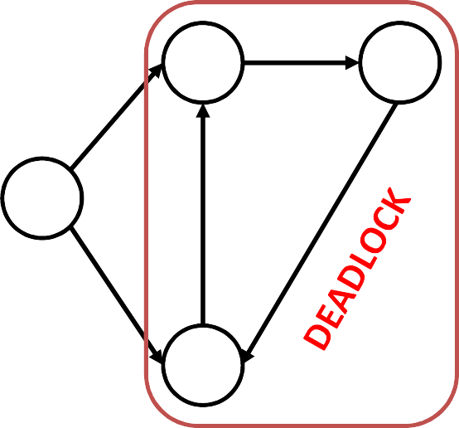
Deadlock detection
B
D
Now this graph contains the cycle.
B D C B
It means that transactions B, D and C are all deadlocked.
A
C
Unit – 6: Transaction Management
71
Darshan Institute of Engineering & Technology

Slide 74
Deadlock recovery
When a deadlock is detected, the system must recover from the deadlock.
The most common solution is to roll back one or more
transactions to break the deadlock.
Choosing which transaction to Selection.
abort is known as Victim
Unit – 6: Transaction Management
71
Darshan Institute of Engineering & Technology

Slide 75
Choice of deadlock victim
In this wait-for graph transactions B, D and C are deadlocked.
In order to remove deadlock one of the transaction out of these three (B, D, C) transactions must be roll backed.
B
D
A
We should rollback those transactions that will incur the minimum cost.
When a deadlock is detected, the choice of which transaction to abort can be made using following criteria:
The transaction which have the fewest locks
The transaction that has done the least work
The transaction that is farthest from completion
C
Unit – 6: Transaction Management
71
Darshan Institute of Engineering & Technology

Slide 76
Deadlock prevention
A protocols ensure that the system will never enter into a deadlock state.
Some prevention strategies :
Require that each transaction locks all its data items before it begins execution (predeclaration).
Impose partial ordering of all data items and require that a transaction can lock data items only in the order specified by the partial.
Unit – 6: Transaction Management
71
Darshan Institute of Engineering & Technology

Slide 77
Deadlock prevention
Following schemes use transaction timestamps for the sake of deadlock prevention alone.
Wait-die scheme — non-preemptive
If an older transaction is requesting a resource which is held by younger transaction, then older transaction is allowed to wait for it till it is available.
If an younger transaction is requesting a resource which is held by older transaction, then younger transaction is killed.
 | Wait-Die
O needs a resource held by Y | O waits
Y needs a resource held by O | Y dies
Unit – 6: Transaction Management
71
Darshan Institute of Engineering & Technology

Slide 78
Deadlock prevention
Following schemes use transaction timestamps for the sake of deadlock prevention alone.
Wound-wait scheme — preemptive
If an older transaction is requesting a resource which is held by younger transaction, then older transaction forces younger transaction to kill the transaction and release the resource.
If an younger transaction is requesting a resource which is held by older transaction, then younger transaction is allowed to wait till older transaction will releases it.
 | Wound-Wait
O needs a resource held by Y | Y dies
Y needs a resource held by O | Y waits
Unit – 6: Transaction Management
71
Darshan Institute of Engineering & Technology

Slide 79
Deadlock prevention
Following schemes use transaction timestamps for the sake of deadlock prevention alone.
Timeout-Based Schemes :
A transaction waits for a lock only for a specified amount of time. After that, the wait times out and the transaction is rolled back. So deadlocks never occur.
Simple to implement; but difficult to determine good value of the timeout interval.
Unit – 6: Transaction Management
80
80

Slide 80
Questions asked in GTU
Write a note on two phase locking protocol.
Explain ACID properties of transaction with suitable example.
What is log based recovery? Explain immediate database modification technique for database recovery. OR Define Failure. Write a note on log based recovery.
State differences between conflict serializability and view serializability.
Explain two-phase commit protocol.
Define transaction. Explain various states of transaction with suitable diagram.
Write differences between shared lock and exclusive lock.
Explain deadlock with suitable example.
What is locking? Define each types of locking.
Define wait-Die & wound-wait.
Unit – 6: Transaction Management
81
Darshan Institute of Engineering & Technology
81

